Slide 1

Mitigating Spectre and Meltdown in LLVM
https://www.io-tech.fi/uutinen/intel-kertoi-edistymisestaan-meltdown-ja-spectre-haavoittuvuuksien-paikkaamisessa/

Slide 2
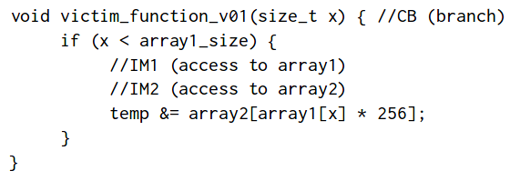
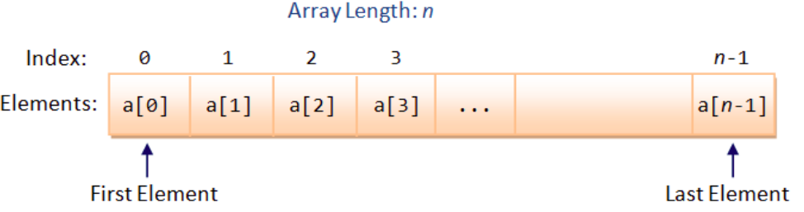
What is Spectre ?
A side channel Attack.
Exploits Speculative Execution.
Untrusted Input sources are exploited.
Affected all the processors in market.
x > n
<number>
Notes:
General Structure, fooling branch predictor, mem access 1 mem access 2 , no isa instruction to
1st train the branch predictor then exploit it’s speculative execution, array2 attacker has access

Slide 3

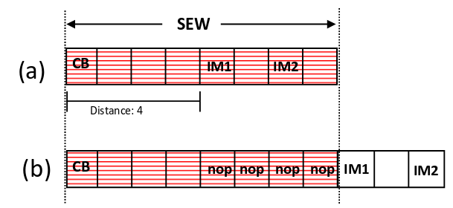
Some Mitigation Methods
<number>
https://arxiv.org/pdf/1807.05843.pdf
Notes:
lfence stops speculative execution and waits, sew - the instructions should be inside the sew

Slide 4
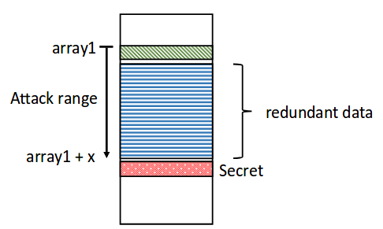
<number>

Slide 5
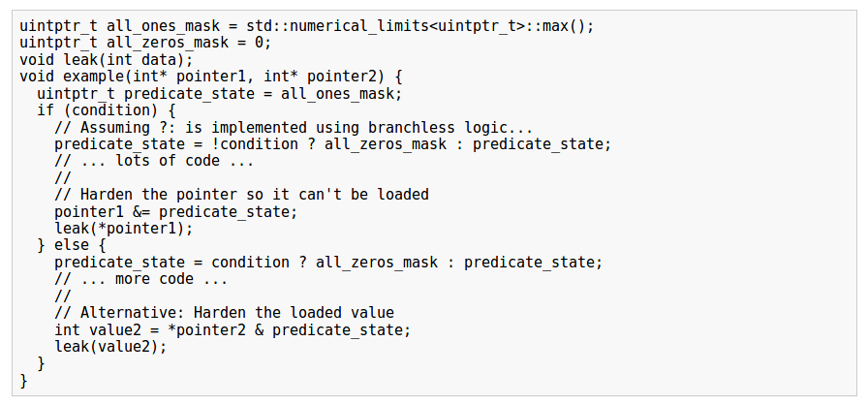
Pointer Hardening
Assuming ternary operator has a branchless implementation.
<number>
https://docs.google.com/document/d/1wwcfv3UV9ZnZVcGiGuoITT_61e_Ko3TmoCS3uXLcJR0/edit#

Slide 6
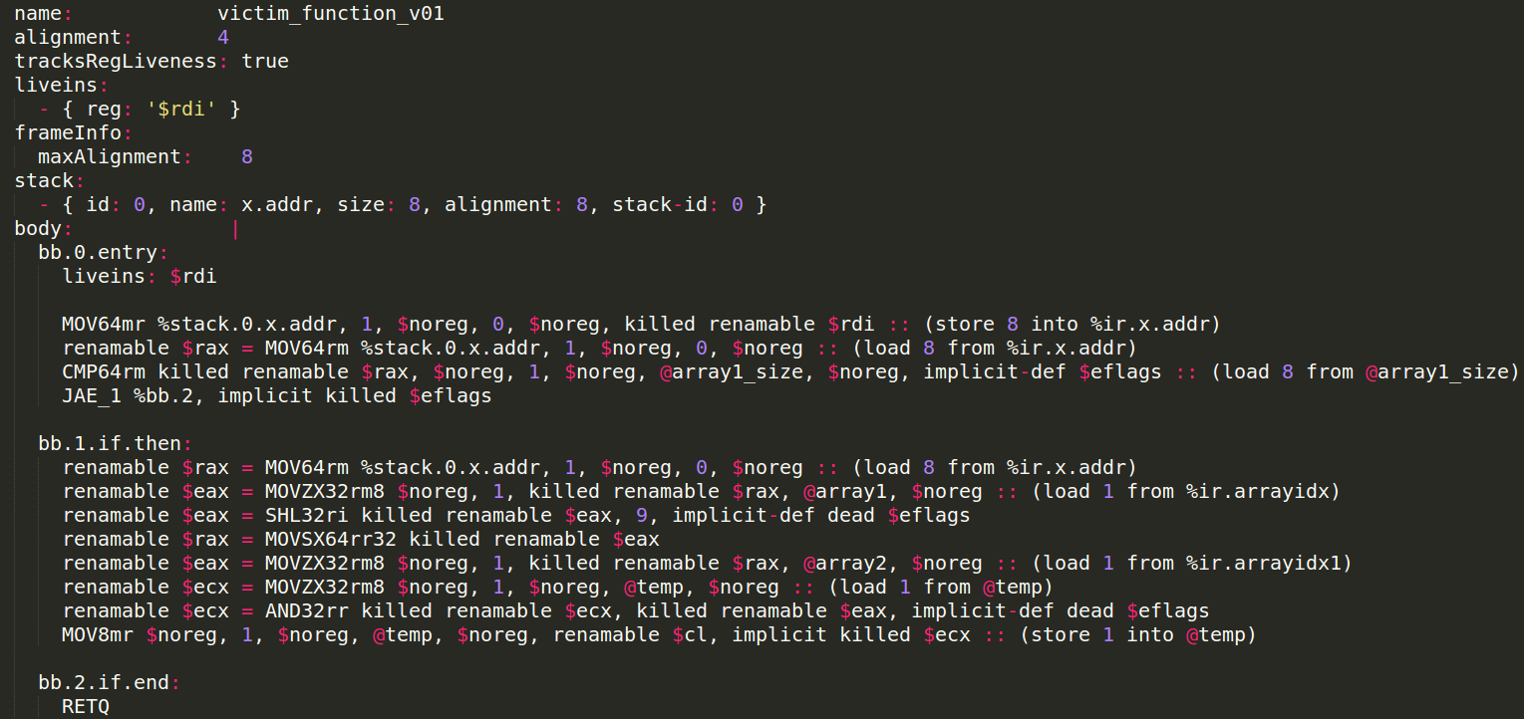
Machine IR(MIR)
MIR is a human readable serialization format .
Represents LLVM’s machine specific intermediate representation.
Uses YAML container.
It is not SSA.
Register Allocation has happened.
<number>

Slide 7
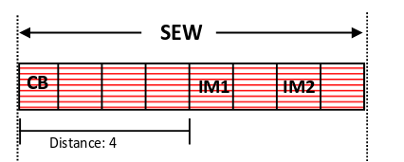
Why MIR and not IR ?
Mitigations added in IR might be removed by the other passes.
Optimisations might remove the vulnerability.
Optimisations might induce the vulnerability.
Calculating the SEW might not be possible.
Better analysis of the vulnerability.
<number>

Slide 8
Why finally IR and not MIR ?
_mm_lfence → declare void @llvm.x86.sse2.lfence()
Spectre works by exploiting high level code.
Happens where untrusted input is used.
Attack requires a lot of tries.
Exploitation of optimisation introduced vulnerability is not practical.
Only test case with ternary operator had it’s vulnerability removed on optimisation.
Bhanu & Aishwarya’s project calculates opCycles. Which should allow us to use SEW.
Analysis is better in MIR but Implementation complexity is more.
Better for creating a POC and initial prototyping.
https://docs.microsoft.com/en-us/previous-versions/hh977023(v=vs.140)
<number>
Notes:
_mm_ allows to put fence in C,

Slide 9
Code Pipeline
Collect Initially Tainted Statements
Get All tainted statements
Intra-Procedural(DU, UD Soup)
Do Intra Procedural Taint Propagation
Insert lfences
Get Tainted Branches.
(Tainted variables & Tainted Mem Operation)
Get All tainted statements
Inter-Procedural(DU, UD Soup)
<number>
Notes:
Modular code,

Slide 10
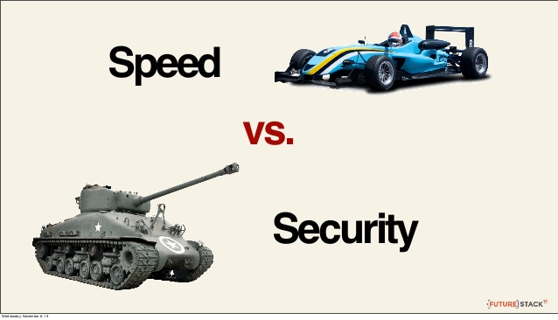
Code Design
Code is modular, any of the parts can be modified without changing other parts.
Currently initial taint is detected for scanf only.
A branch is tainted if:
Outcome of branch depends on Tainted Variable
Blocks it leads to contains Tainted Memory access.
Security is preferred over speed.
Fences are added at some non - spectre branches also.
All code Snippets
Spectre
<number>

Slide 11

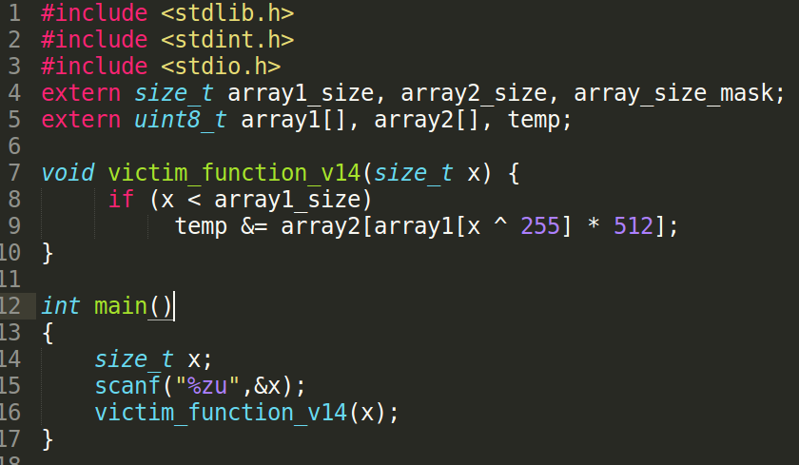
Testing
Author: Spectre Attacks: Exploiting Speculative Execution
Gave 15 Spectre test cases.
Microsoft’s solution failed 13 .
oo7 failed 1 of them.
Made test cases into proper program to run pass.
Paul Kocher
<number>
https://www.paulkocher.com/doc/MicrosoftCompilerSpectreMitigation.html

Slide 12
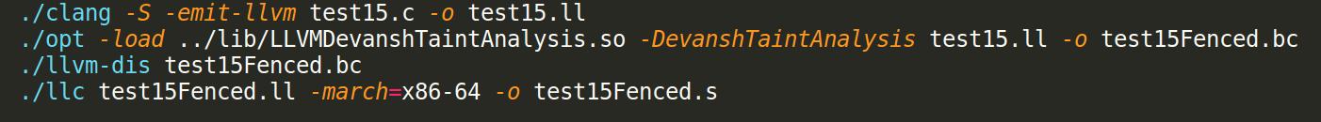
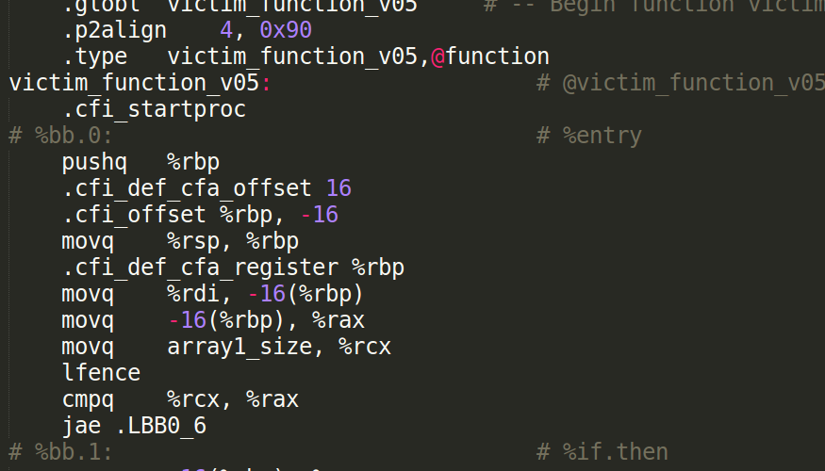
Commands Used
Output
Lfence gets added before the tainted branches.
<number>

Slide 13
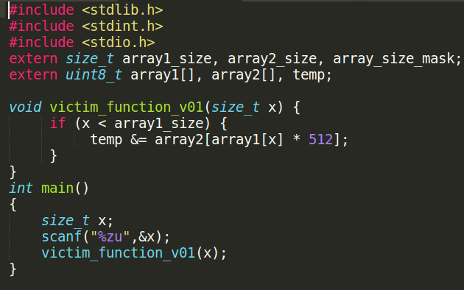
Test case 1 (C Program)
Both Microsoft & oo7 passed this.
<number>
https://github.com/svkeerthy/CompilerEngg18/tree/master/lib/Transforms/DevanshTaintAnalysis

Slide 14
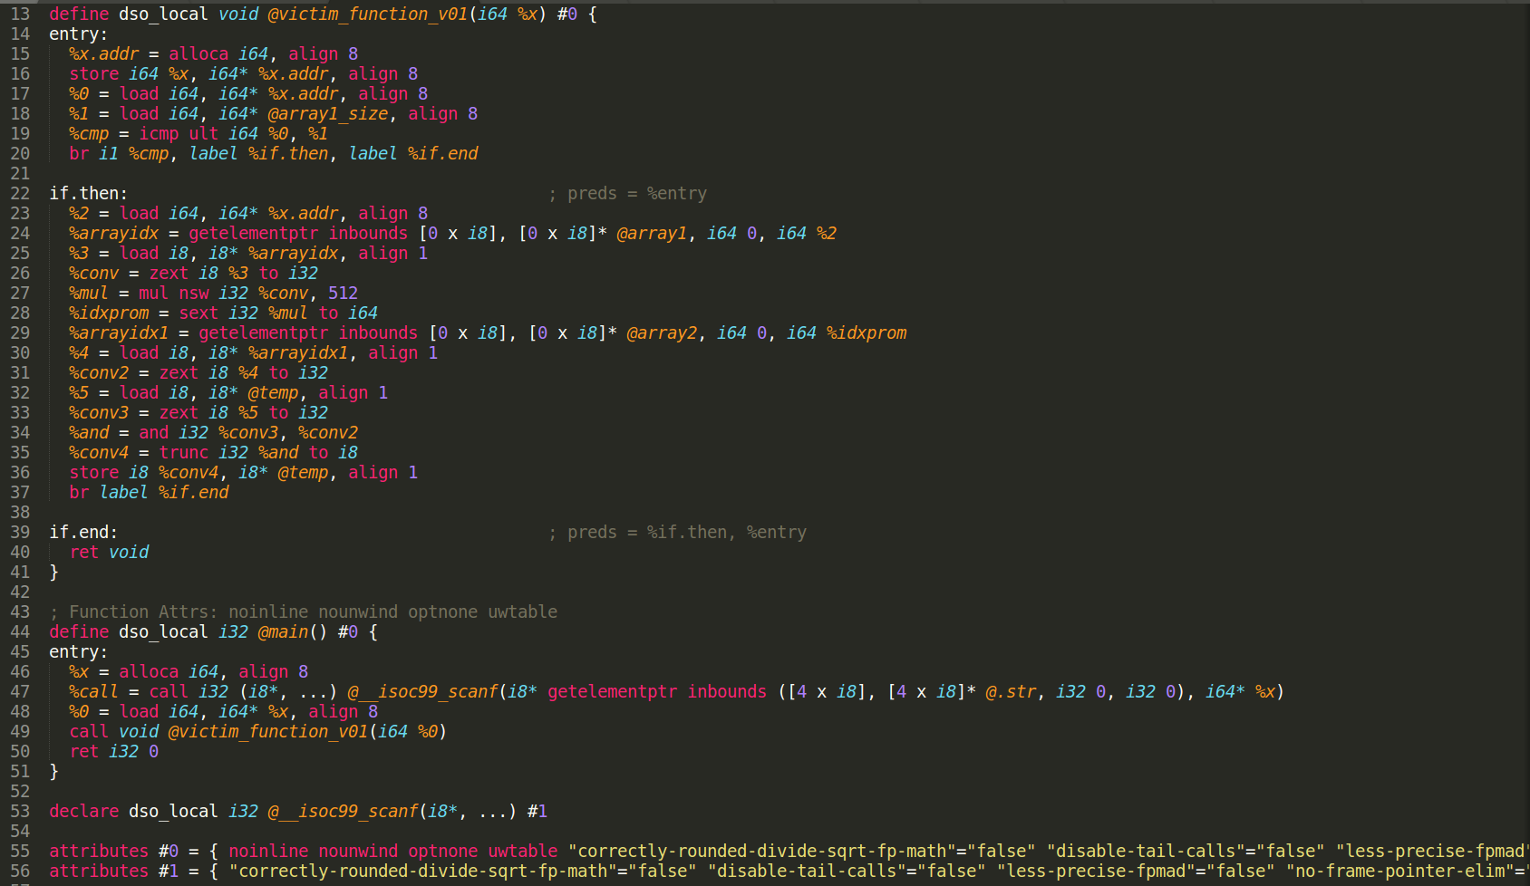
Test case 1(IR)
<number>

Slide 15
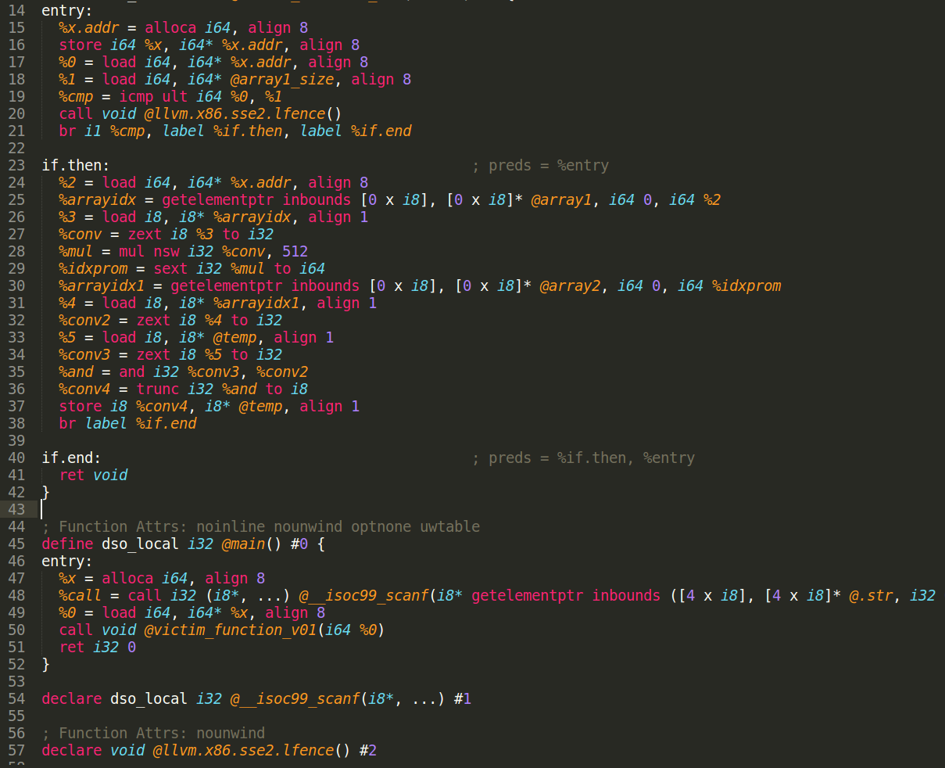
Test case 1(IR Fenced)
<number>

Slide 16
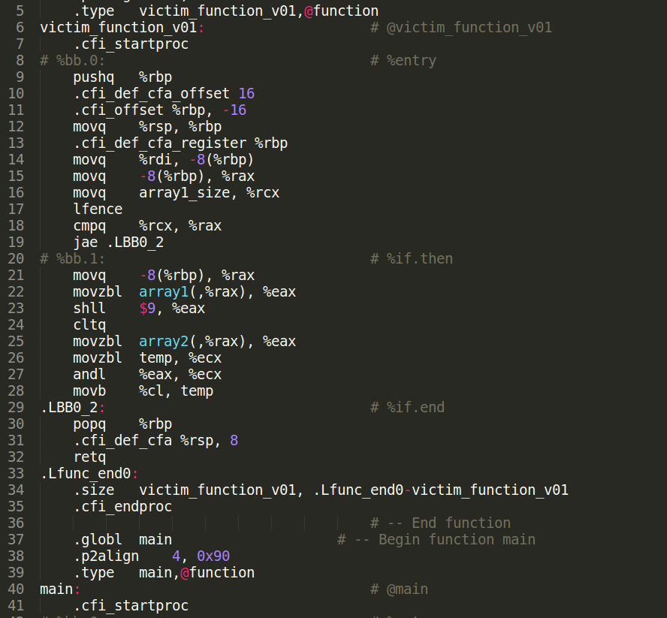
Test case 1(Assembly Fenced)
<number>

Slide 17
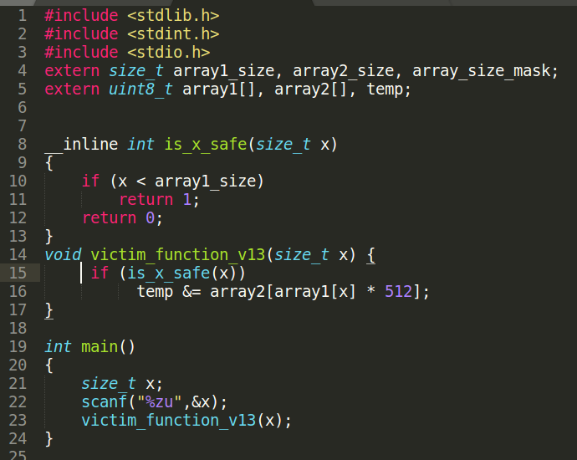
Test case 13 (C Program)
Both Microsoft & oo7 failed this.
<number>

Slide 18
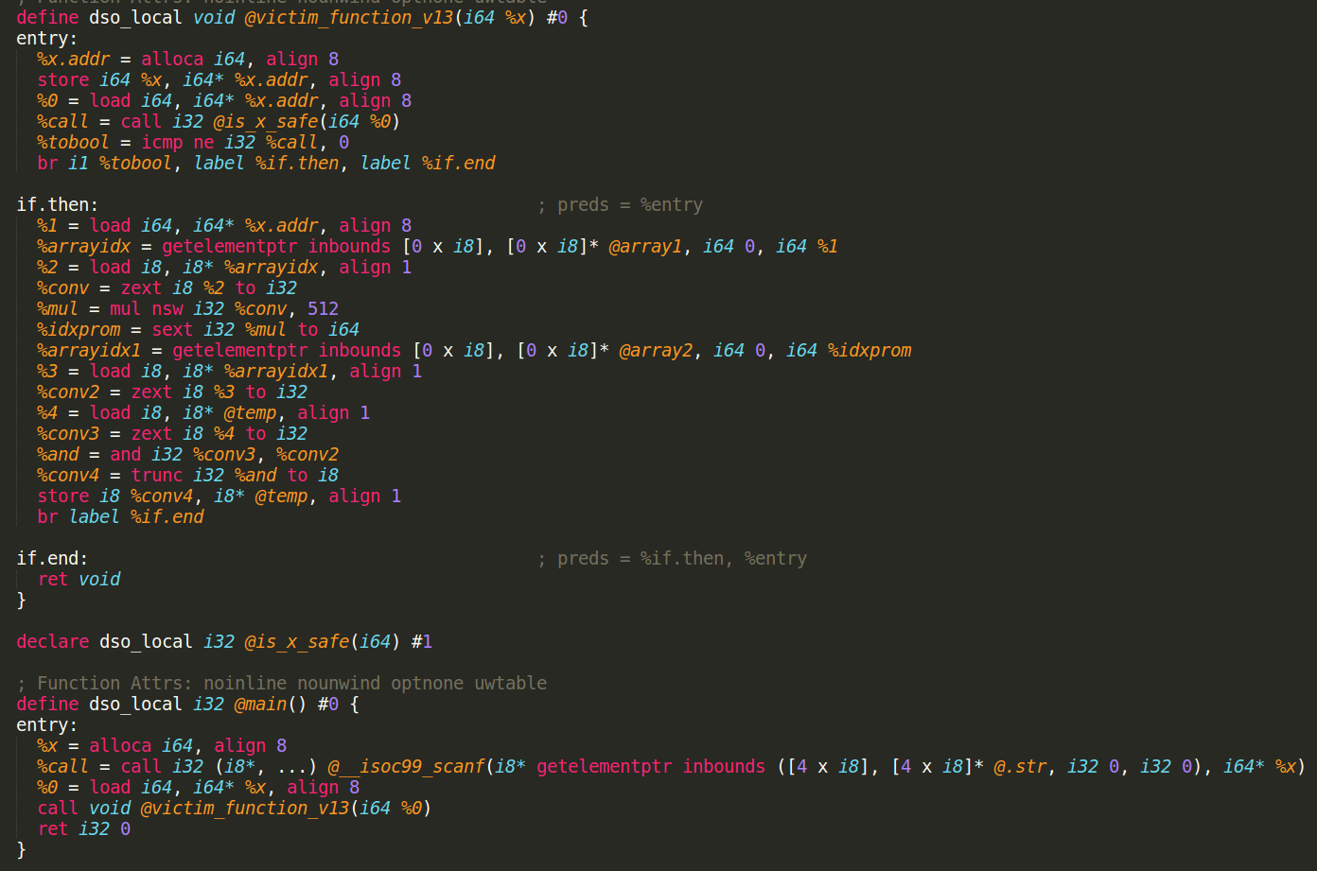
Test case 13 (IR)
<number>

Slide 19
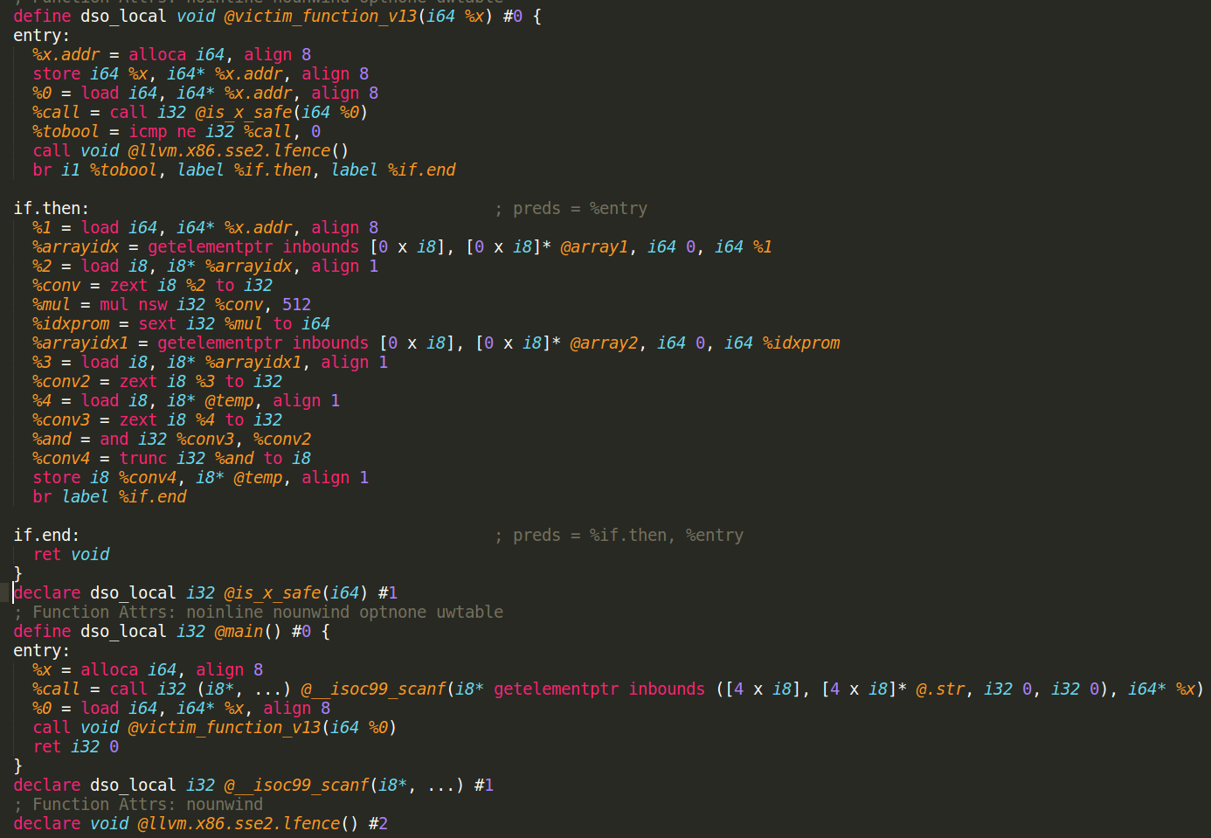
Test case 13 (IR Fenced)
<number>

Slide 20
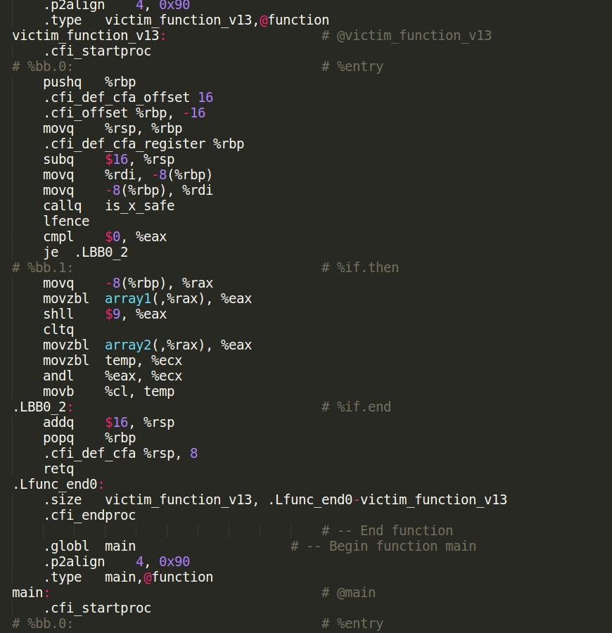
Test case 13 (Assembly Fenced)
<number>

Slide 21
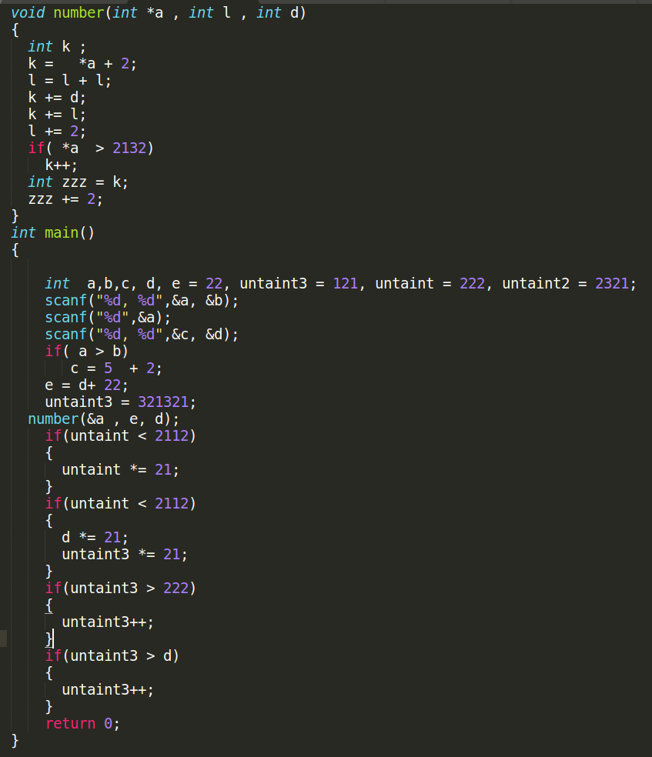
Example: Untainted Branches Not Fenced
<number>

Slide 22
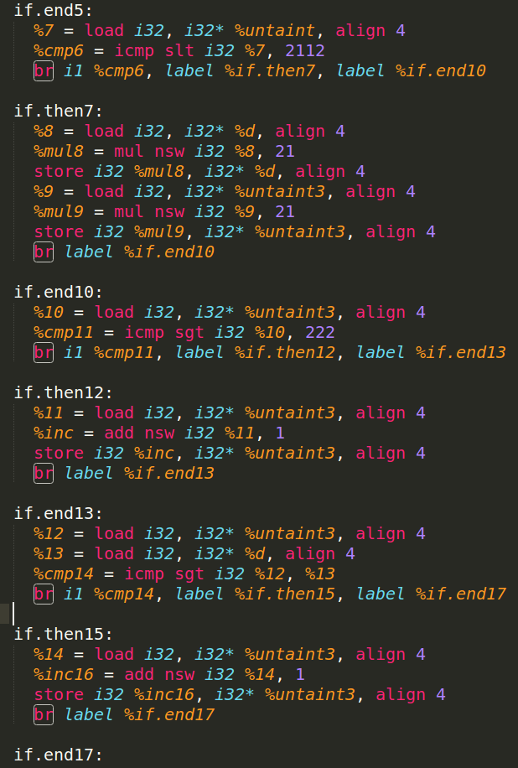
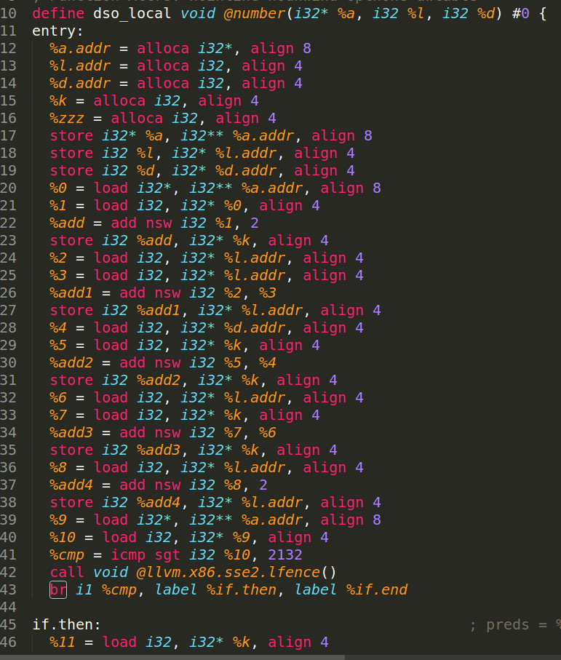
Example: Untainted Branches Not Fenced
<number>

Slide 23
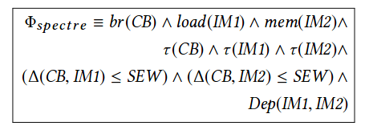
Conclusion
All code Snippets
Proposed solution that works for all the 15 test cases.
Is not the tightest bound.
So some non - spectre branches also get flagged.
The bound can be made more tight without changing other parts.
By using SEW .
Checking dependency between IM1 & IM2.
Currently the initial taint is limited to scanf.
But new initial taints can be easily added.
Data from server.
Message from IPC.
File read or write.
Fenced
Spectre
<number>
Notes:
A somewhat mid way solution is proposed

Slide 24


Something I came across while looking at automated Taint Analysis
A CTF between computers with no human intervention.
https://www.darpa.mil/program/cyber-grand-challenge
<number>

